Slide 1
Full-Stack Web Development Lecture 5: Version Control Systems Ashley Williams Ashley.Williams@mmu.ac.uk

Slide 2
Learning Objectives
To understand:
What version control systems (VCS) are?
What motivates developers to adopt VCS in industry?
How can we effectively use VCS in our own projects?

Slide 3
Unit Overview
# | W/C | Lecture | Lab
1 | 03/10/2022 | Introduction to Full-Stack | Recap/RESTful APIs
2 | 10/10/2022 | Introduction to NodeJS/ExpressJS | Getting started with NodeJS/ExpressJS
3 | 17/10/2022 | Interacting with Databases | Interacting with Databases
4 | 24/10/2022 | Handling Authentication | Handling Authentication
5 | 31/10/2022 | Version Control | Assignment Support: Backend
6 | 07/11/2022 | API Security and Scaling | Assignment Support: Backend
7 | 14/11/2022 | Introduction to VueJS | VueJS Basics
8 | 21/11/2022 | Style, Layout, and Navigation | Layout and Navigation
9 | 28/11/2022 | Networking | Handling API requests
10 | 05/12/2022 | Structuring and Refactoring | Assignment Support: Front-end
11 | 12/12/2022 | Code Quality | Assignment Support: Front-end

Slide 4
VCS – the basics
How many of us have used version control systems in our software projects?
Assignments?
Side projects?
Work projects?

Slide 5
VCS – the basics
VCS is software that allows us to keep track of changes made to a directory
(similar to the same way that Google Docs tracks changes to documents, and Trello tracks changes to boards that we create)
This allows us to keep a history of the changes that have been made and allows us to work collaboratively with others
(e.g. if we break our application, then we can revert back to a previous version)

Slide 6
VCS – the basics
VCS capture the state of a given directory and all of the files and folders within the directory.
The state is stored as a series of snapshots (i.e. the state of the directory at a particular moment in time)
Each snapshot is accompanied by a collection of metadata about the changes that have been made as part of that snapshot:
Who made the changes?
When were the changes made?
Which specific files were changed? Which specific lines where changed?
Why were the changes made? – through a developer provided ‘commit’ message

Slide 7
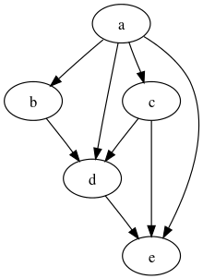
Git
There are many different types of VCS, but the most popular by far is a VCS called ‘git’
Git uses a “Directed Acyclic Graph” (DAG) to model a directories changes over time
A directed graph
With no directed cycles
Sounds more complicated then it is…
Essentially, a Git snapshot knows about itself, and the previous snapshot(s) from which it is formed
Source: https://en.wikipedia.org/wiki/Directed_acyclic_graph

Slide 8
Git
So, imagine that we have a snapshot, we make a change and create a new snapshot, and then make a change and create a third snapshot. Our graph will look like the below:
This is the most simple of examples of how Git works. The only difference between this and just saving different versions of the directory as you go is that you also have the metadata that we discussed before.
But what about collaboration? Or working on multiple features at the same time?

Slide 9
Git - branching
Well, with Git’s data model, we can also fork the snapshots to create multiple “branches”
With this, you can implement features/bugfixes on different branches without affecting each other, and have multiple developers working on different parts of the system without getting in each other's way.
However, now you have multiple versions of the codebase that all do different things – so we need a way to bring everything back together…

Slide 10
Git - merging
Git provides us with functionality for merging branches
The merge brings together the changes from each branch into an amalgamation of them all

Slide 11
Git - merging
There may be some problems here.
For example:
Instances where both branches changed the same line, and git doesn’t know which is correct
Instances where one branch breaks another
Instances where changes in one branch aren’t necessary when merged with another
This is called a ‘merge conflict.’ Git presents merge conflicts back to the user for them to decide how to solve

Slide 12
Git – data model
The Git data model is straightforward and easy to understand
Commits are stored using a hash of the snapshot as its ID
This means that you can retrieve a commit using its ID. However, instead of having to remember the hashes, git also stores a set of easy to remember aliases/references e.g. “added button to send user to help section”
type blob = array<byte>
type tree = map<string, tree | blob>
type commit = struct{
parents: array<commit>
author: string
message: string
timestamp: int
snapshot: tree
}

Slide 13
Git – data model
Commits and ID’s can’t be changed, but the aliases can be updated.
E.g. point to a different commit
“Added button”

Slide 14
Collaboration Workflows using Git
There are multiple different ways for working with Git – it is important to find a workflow that suits your needs
A good workflow model should:
Scale with team size
Allow for each undoing of mistakes
Not impose any new unnecessary cognitive overhead to the teams

Slide 15
Collaboration Workflows: Centralised Workflow
Very basic and a good starting point for teams transitioning from other centralised VCS
There is only one branch (the master branch)
Each developer works on their own local copy of the branch
Once they complete a piece of work (e.g. a new feature) on their local version, they commit to the shared repository – handling any merge conflicts as they go
Read more: https://www.atlassian.com/git/tutorials/comparing-workflows#centralized-workflow

Slide 16
Collaboration Workflows: Feature branching
Similar to the centralised workflow, only each feature is developed on its own branch before being committed to the master branch.
This allows for developers to work on a particular feature without disturbing others, and also means that the master branch should never contain broken code
Read more: https://www.atlassian.com/git/tutorials/comparing-workflows/feature-branch-workflow

Slide 17
Collaboration Workflows: Gitflow and forking workflow
Gitflow Workflow: similar to feature branching, but assigns strict and specific roles to different branches for managing the release cycle of large projects
Read more: https://www.atlassian.com/git/tutorials/comparing-workflows/gitflow-workflow
Forking Workflow: Instead of all developers working from a single, shared repository. Each developer also has their own local repository. Developers push to their own repository, and only the project maintainer can push to the official repository. This workflow is used in most open source projects
The branching model is similar to the Gitflow workflow, meaning that complete feature branches will be purposed for merging into the repository. This distributed workflow provides a flexible method for large teams to collaborate securely.
Read more: https://www.atlassian.com/git/tutorials/comparing-workflows/forking-workflow

Slide 18
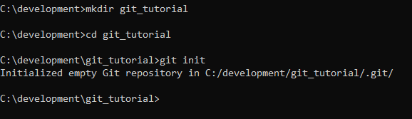
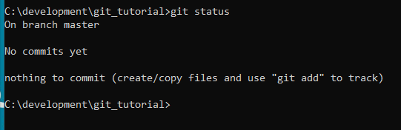
Initialise a Git project
We initialise the directory, telling Git that this is the root of the project that we want to track
“git status” provides an overview of the current state of the repository

Slide 19
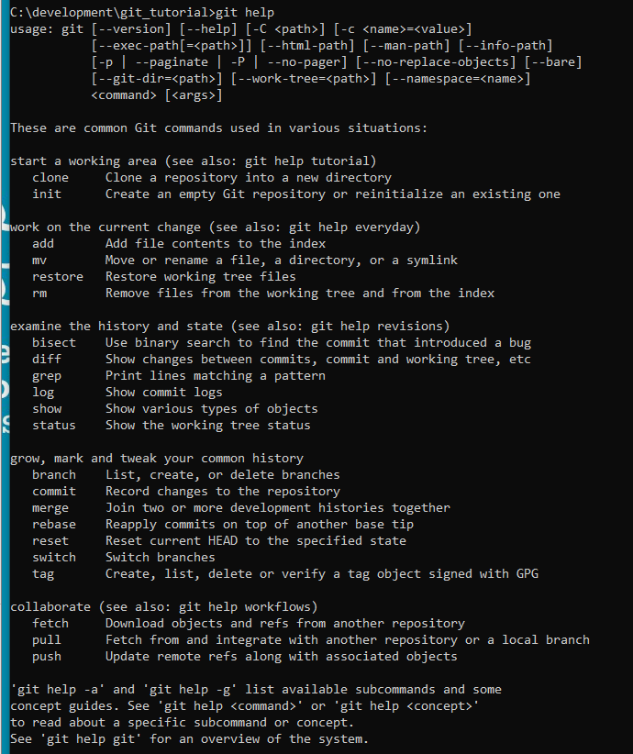
Initialise a Git project
“git help” provides instructions on how to use a specific command

Slide 20
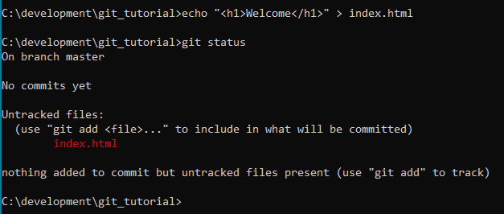
Create a file
Create a new file “index.html”
Git has a staging area for you to state what you want to include in the next commit.
Git status still says no commits, but we can see our new file marked as untracked

Slide 21
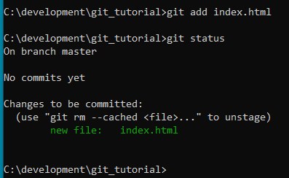
Create a file
We need to tell git that we want to include this file by adding it to our staging area
Git status now shows that the file is part of the repository, and ready to be committed

Slide 22
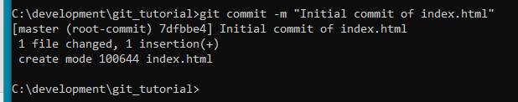
Committing to the repository
Here we are committing a new snapshot to our repository, with the commit message “Initial commit of index.html”

Slide 23
Writing high quality commit messages
It’s important to always write high quality commit messages
Why?
So we can see why we made a certain change to our system
So other developers know what we have changed and why
Writing high quality commit messages:
There are many conventions for writing good commits. If you are not being told which convention to use by your company, best to learn one well and stick to it
Some tips:
Specify the type of commit
Format whitespace/proper spelling/punctuation etc
Don’t assume that the review understands what the original problem was
Read more: https://www.freecodecamp.org/news/writing-good-commit-messages-a-practical-guide/

Slide 24
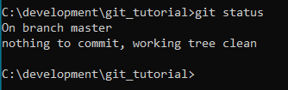
Committing to the repository
So, we have committed to our repository and git status now looks as follows:
In terms of our previous examples, our repository now looks like this:

Slide 25
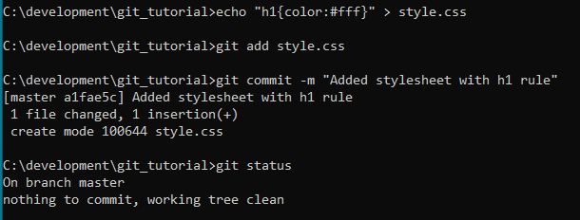
Adding another commit
Let’s add another file, add it to the staging area, and commit it
Our repository now looks like this:

Slide 26
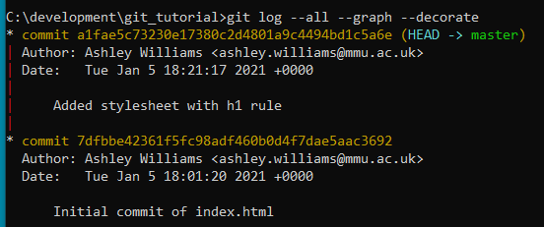
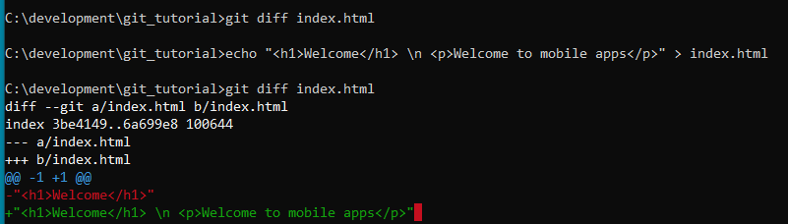
Visualising in the terminal
“git log --all --graph --decorate” visualises the commit history as a graph in our terminal.
The most recent commit is at the top
“git diff” can be used to see what has changed since the last commit

Slide 27

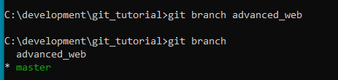
Branching
“git branch” lists all of the available branches
(“master” is the name of the default branch in git projects)
“git branch <name>” creates a new branch

Slide 28

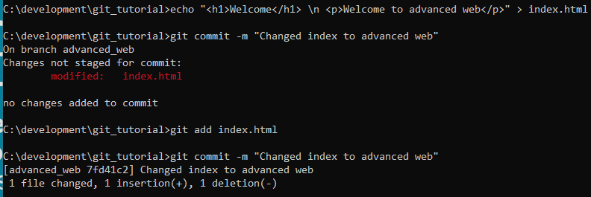
Branching
“git checkout <name>” replaces the content of the working directory with the specified branch
Let’s make a change and commit
(we need to add the file to the new branch)

Slide 29
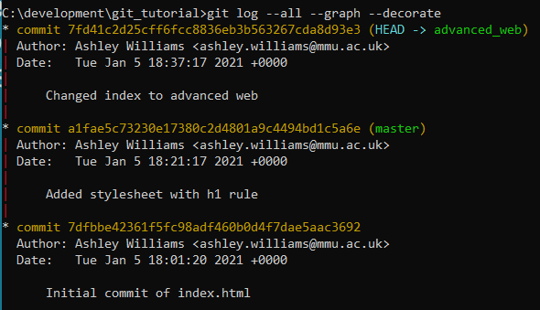
Branching
Our graph shows that our parent commit was on the master branch

Slide 30


Branching
If we switch back to the master branch and look at index.html, we can see that the new change isn’t there
Our repository now looks like this:
Master
Advanced Web

Slide 31
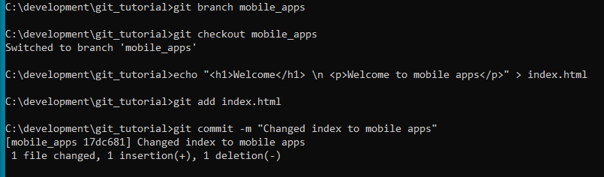
Branching
Let’s create a third branch, make a change, and commit
Our repository now looks like this:
Master
Advanced Web
Mobile apps

Slide 32
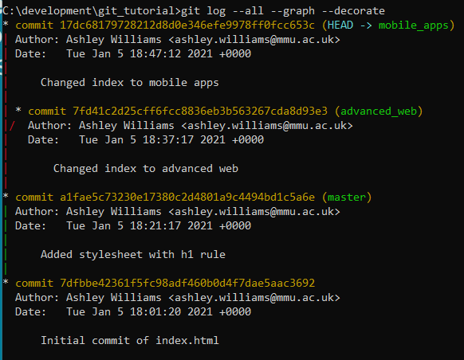
Branching
Our graph shows the branches in the terminal

Slide 33
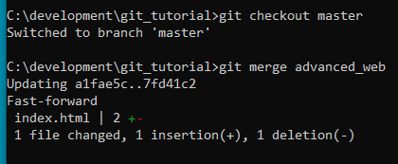

Merging
Let’s switch back to the master branch and merge the advanced web branch with it
The index.html file on the master branch has now been merged with the advanced_web version

Slide 34
Merging
Our repository now looks like this:
Master
Advanced Web
Mobile apps

Slide 35

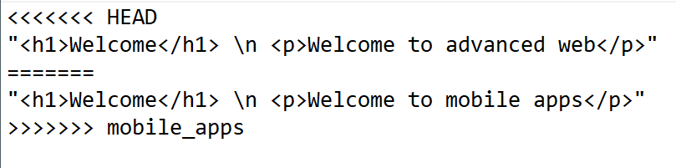
Merging
When we now merge the master with the mobile_apps branch, a merge conflict occurs because both branches edit line 1 of the index.html file
We can see the conflict in index.html

Slide 36
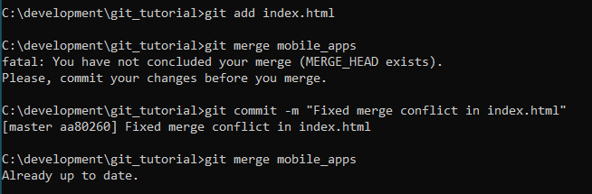
Merging
We manually edit the file to fix the conflict, deciding that we want to keep the mobile_apps version of the file.
We save the file, re-add the file, re-commit and then re-try the merge

Slide 37
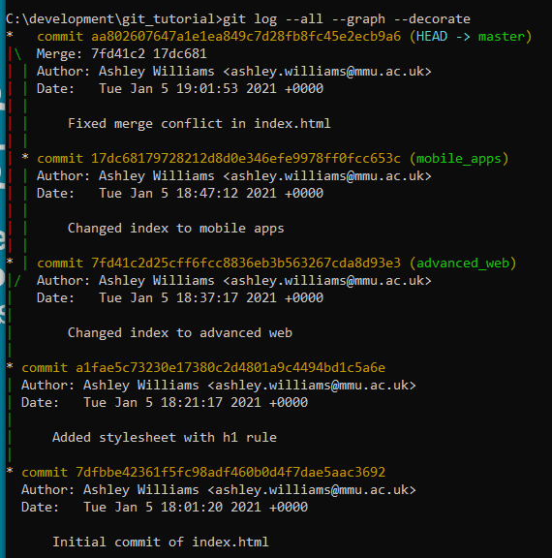
Merging
The merge can be seen in our terminal

Slide 38
Merging
Our repository now looks like this:
Master
Advanced Web
Mobile apps

Slide 39
GitHub
Git and GitHub operate independently of each other
GitHub is one type of Git “remote” –
A remote store for keeping a copy of your repository
(this could also be a shared server, GitHub, another directory on the same hard drive)
Why use remotes?
Well everything is still currently on one hard drive…
What happens if that drive dies?
Or we want to share the repository so that multiple developers can work on the same project?

Slide 40
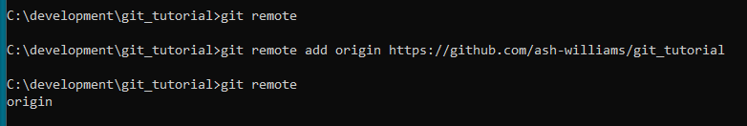
GitHub
“git remote” lists all of the remotes configured for this repository
“git remote add <name> <url>” is the command used for adding a new remote
(“origin” is usually used as the alias when there is only one remote)
(you first need to create the repository in GitHub from your account)

Slide 41
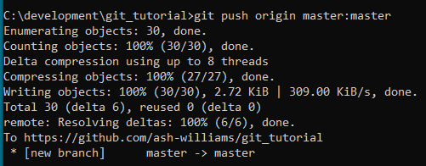
GitHub
To sync our local repository with a remote, we use “git push <remote> <local branch>:<remote branch>”
E.g. git push origin master:master

Slide 42
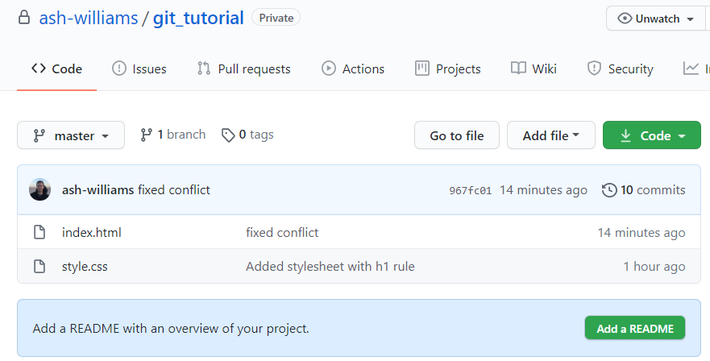
GitHub
Our repository has synced with our GitHub remote

Slide 43
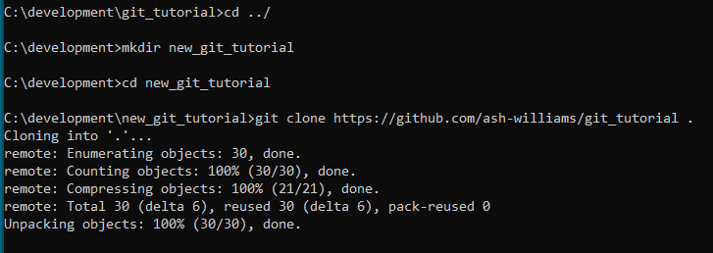
GitHub – getting from a remote
There are two main reasons for wanting to retrieve a repository from a remote:
1. We are pulling a repository into an empty directory to work on it or use it
2. We are pulling a new version of a repository to bring it in sync with your local version of the repository
For the first, we can use the “git clone” command. (e.g. you will all have cloned the starter
code – hopefully!)

Slide 44
GitHub – getting from a remote
For syncing remote repositories with your local version, you need two commands:
“git fetch” – downloads all of the commits, files and refs from the remote repository
“git merge” – merges the remote changes with your own local repository
Alternatively, you could use “git pull,” which carries out a “git fetch” followed by a “git merge”

Slide 45
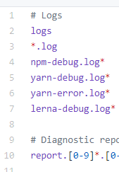
.gitignore
The .gitignore file is a file that we can place in the root of our repository. It contains a list of patterns.
Files and folders that match these patterns will be “ignored” by git (i.e. not added to the repository)
Useful when dealing with:
Log files
Env files
Static assets (sometimes)
node_modules !!!

Slide 46
Other bits
Git config – there are many configuration commands that you can use to make using git smoother and more tailored to your needs
Read more: https://git-scm.com/docs/git-config
IDE integration – almost all IDE’s will provide some form of tooling for integrating with Git. I don’t use them myself, and there are far too many to cover, but there are a lot of tutorials. Find one for your specific IDE if interested.

Slide 47
How I use Git/GitHub – as a solo developer…
Create the repo in GitHub
make sure no license or README is created – just an empty repo
Start coding my project
In the project directory, initialise git:
git init
git add .
git commit –m “initial commit”
git remote add origin <link to repo>
git push origin master
Then periodically:
git add .
git commit –m “commit message”
git push origin master

Slide 48
This week’s lab
In this week's lab, you will:
(optional) There is a Git worksheet for you to work through
Work on your assignment application
Assignment Checklist:
Complete all end-points
Ensure your application passes all tests

Slide 49
Questions?

Slide 50
Sources
https://www.atlassian.com/git/tutorials/learn-git-with-bitbucket-cloud
https://git-scm.com/docs/gitignore
https://www.youtube.com/watch?v=2sjqTHE0zok

